Slide 1


Robotics Workshop Week 1 Intro to Electronics
Notes:
Hello everyone, its great to see so many of you here at this first session.
My name is ______, I organize and create theses workshops as a part of hackSussex, which is the the main computer science society here.
Now, because this is the first session ill give a short description about what you can expect from attending.
So in these workshops you’ll learn the basics of electronics, mechanics, coding and robotics, to quickly build your knowledge on this under-represented yet impressive area of Engineering and Computing.
The workshops assume you don’t know anything, so it doesn’t matter if you have never used this hardware or software before, and even if you have you shouldn’t be getting bored.
As you may seen on the robotics posters, this is a hands on workshop, so only a small amount of time is spent teaching via presentation.
Instead you get custom worksheets that I’ve spent countless hours creating and improving for a much more involved experience.
Now, a normal 2 hour session would generally involve me talking for 10-15 minutes about todays topic.
Then, in groups 2 – 4 you’d go through the worksheet using the provided hardware. You’re working in groups so you can share your knowledge, meet new people and solve problems collectively.
While your working together, we’ll be going between groups to provide help where needed and to get to know you better.
The last 20 minutes or so will involve packing up the equipment and having a short Q&A about anything related.
Just to let you know the first few workshops will be simpler than later ones. This is to allow people to properly understand the basics and miss a few sessions if they get freshers flu.
And with that out of the way, lets get started. In today’s workshop you will be introduced to some basic electronics and micro-controllers.

Slide 2
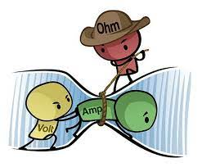
Basics of electronics
Voltage, V, measured in Volts
Current, I, measured in Amps
Resistance, R, measured in Ohms
Related by Ohm’s Law: V = I * R
Notes:
In electronics you have 3 variables key variables to think about when creating circuits. Current, which is a measure of the rate of flow of charge through a wire, electrons hold this charge, so current is a measure of the rate of flow of electrons through a wire.
Voltage, this is a measure of the potential for charge to flow through a wire, analogous to the potential a rock has at the top of a hill to roll down.
And resistance, simply a property that resists the flow of charge in a wire.
These 3 factors are all related to each other through Ohms law. Where voltage equals current multiplied by resistance.

Slide 3
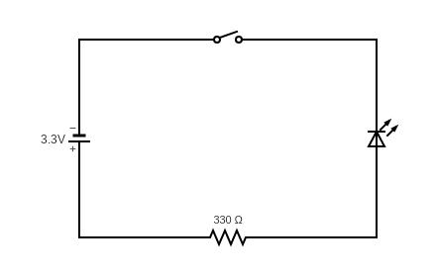
Basics of electronics
Notes:
This is a basic circuit diagram, on the top you have a switch, currently the switch is open so no current can flow.
On the left is a battery/power supply giving 3.3v, on the right is an LED.
LED stands for light emitting diode, diodes are electrical components that only allow electricity to flow in one direction, and with it being a light emitting diode it only emits light when its powered in one direction.

Slide 4
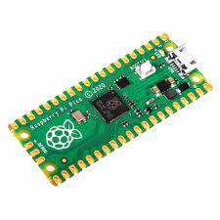
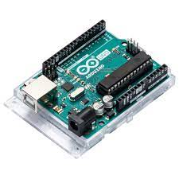
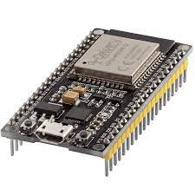
What is a micro controller?
Notes:
Does anyone want have a go at explaining what a micro-controller is?
A micro controller is a small device that lets you program and control its inputs and outputs in the form of electrical signals with code. All of these are different types of micro-controllers. We’ll be using the one on the left called a Raspberry Pi Pico.
All of those golden tabs can be connected to wires, and then controlled with code.

Slide 5
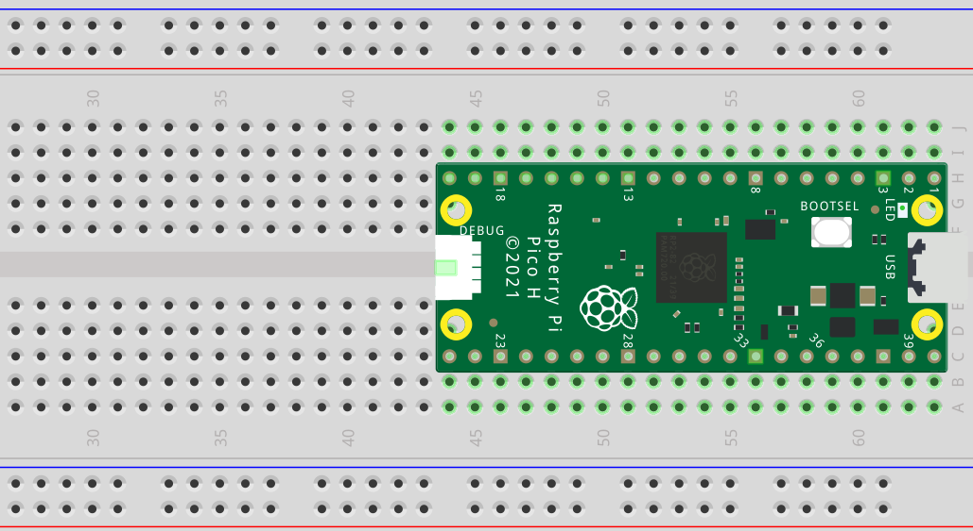
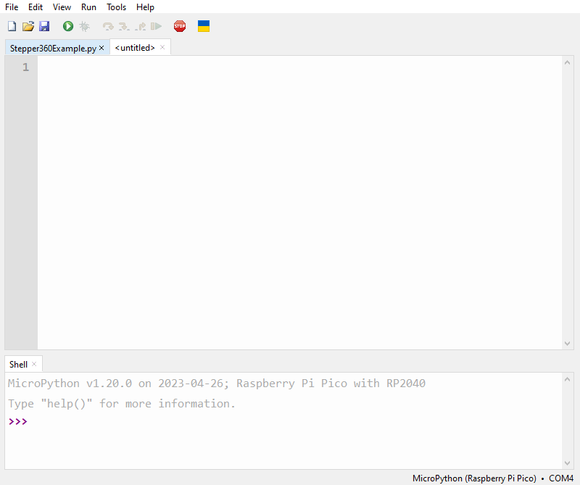
How to use the Pi Pico?
Hardware side Software side (Thonny)
Notes:
() – brackets indicate in person pointing out.
How do you use a Pi Pico?
On the hardware side you can connect the Pi Pico’s pins (all of these) to various devices with wires, however for most workshops your Pi Pico will be on a bread board (one of these).
These allow you to more easily connect and mount various electrical components together. They work by creating an electrical connection between pins plugged into the same row or column.
(all of these pins are electrically connected in a column, but these pins which are also connected in a column are not electrically connected to the coulomb above, and that’s the same across the whole center section)
(for the 2 rows at the top and bottom, these generally are used for power and ground because each row is electrically connected across the whole board)
Now on the software side when you connect your Pi Pico to a computer using the provided cables, and launch Thonny, you can write a program for the Pi Pico in Python then upload and run the code.
The worksheets have detailed instructions on how to connect and program the Pi Pico with Thonny so I wont go into any more detail here.

